Slide 1


Probabilistic Machine Learning with PyMC3
Statistical Modeling for Engineers
Make sure to watch in slide mode!
Dr. Thomas Wiecki
@twiecki
Lead Data Scientist
Notes:
Thank you all for joining, I’m Thomas Wiecki, Data Science Lead at Quantopian.
Today I wanted to talk about a modeling framework that I think is perfectly suited for data scientists coming from computer science rather than statistics
Unfortunately not enough time to give a full tutorial but I wanted to
Demonstrate probabilistic programming here by showing how we solved a real-world problem we actually have at Quantopian
So what’s Quantopian?

Slide 2
Disclaimer
This presentation is for informational purposes only and does not constitute an offer to sell, a solicitation to buy, or a recommendation for any security; nor does it constitute an offer to provide investment advisory or other services by Quantopian, Inc. ("Quantopian"). Nothing contained herein constitutes investment advice or offers any opinion with respect to the suitability of any security, and any views expressed herein should not be taken as advice to buy, sell, or hold any security or as an endorsement of any security or company. In preparing the information contained herein, Quantopian, Inc. has not taken into account the investment needs, objectives, and financial circumstances of any particular investor. Any views expressed and data illustrated herein were prepared based upon information, believed to be reliable, available to Quantopian, Inc. at the time of publication. Quantopian makes no guarantees as to their accuracy or completeness. All information is subject to change and may quickly become unreliable for various reasons, including changes in market conditions or economic circumstances.

Slide 3
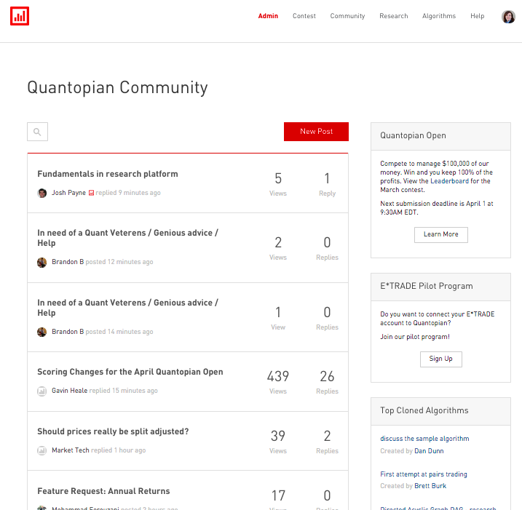
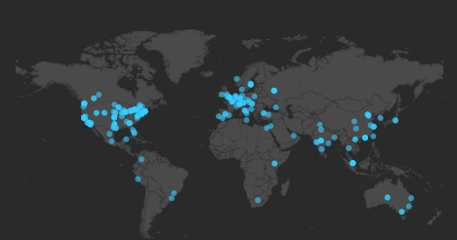
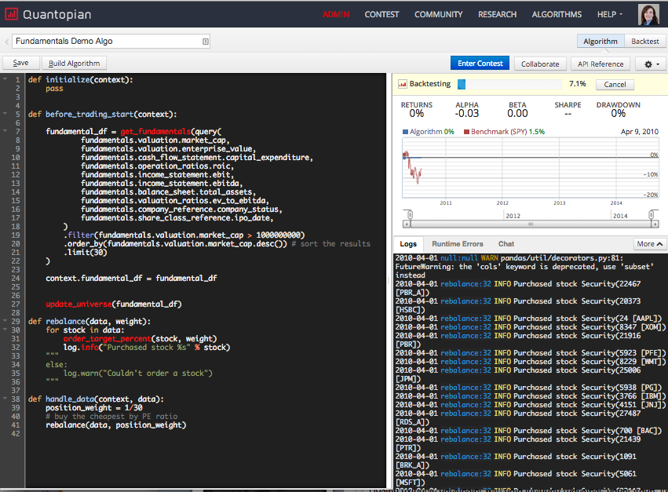
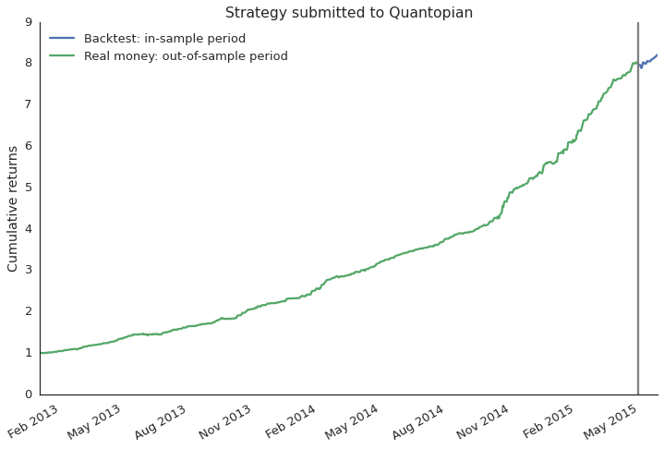
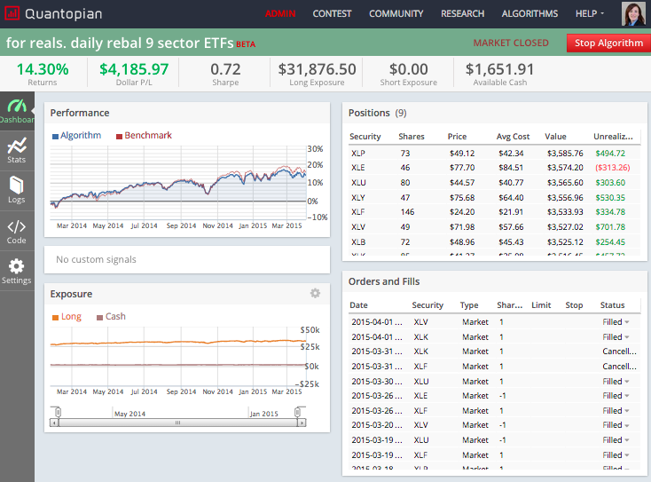
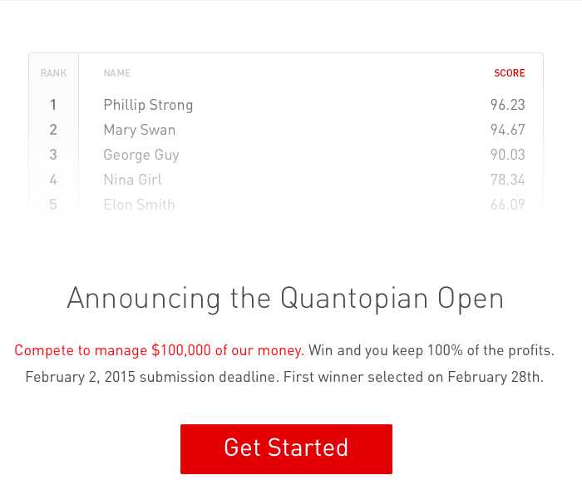
Quantopian
>85.000 users
Community,
backtester + data,
real-money trading
competitions
Select best trading strategies and invest capital
Notes:
Instead of that traditional model with few quants, we have over 50000 users working on algorithms
We provide
a community that thrives on openness
a backtester where you can code your strategy in python and test on 13 years of historical minute-resolution data,
you can then deploy real money to your strategy and run it hosted on quantopian,
trading competitions where you can win $100.000 deployed to your algorithm and you keep all the profits
and the best thing is: all of this is free and everyone can use it!
We then deploy outside capital to these strategies and share the profits with the quant.
Now we on the research team have to select the strategies from this huge pool that act
ually work. This is actually a very hard problem because:
We don’t look at the code and we have 100s of thousands of these so there is a scaling problem

Slide 4
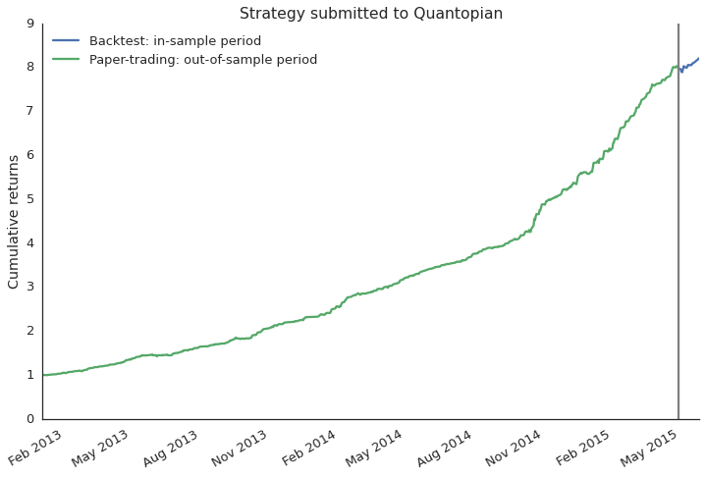
How to select strategies for fund?
paper trading
backtest
Notes:
Most historical backtest performances look amazing, they almost never lose money
Then however, when you set it live and deploy it with capital a common failure mode is that it does not seem to perform as the backtest suggested
Problem is, it is very easy to overfit the backtest so that it only works on historical data but not going forward

Slide 5
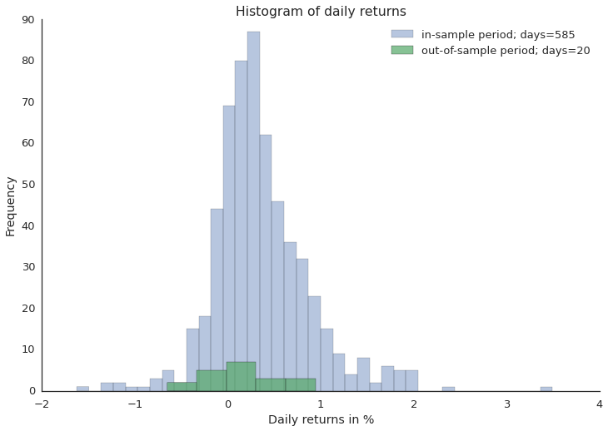
Does out-of-sample data support backtest?
Notes:
Another way to look at that same data is just as a histogram of daily returns
Here the question becomes, do the out-of-sample returns come from the same distribution as the in-sample returns
Difficult problem because out-of-sample data is always scarce and returns are generally noisy
Now how would you solve that problem? There are several approaches that a data scientist might follow.

Slide 6
Blackbox Machine Learning
Classifier
Data
Predictions
Train classifier to distinguish between distributions.
Classification framework not well suited.
Blackbox: Not good at conveying what was learned.
Notes:
It is fair to say that machine learning has revolutionized data science and is definitely the go-to choice in a lot of cases. But how might we apply it in this specific case?
One possibility would be to try and train a classifier and if it is able to differentiate between these two distributions in cross-validation we would assume that the backtest is overfit.
Now you will probably say that machine learning is just not the right tool for the job in this case and that is precisely the point I am trying to convey.
Most machine learning algorithms are very static in what they do so to apply them we would have to change our problem and shoe-horn it into this framework: “If your only tool is a hammer, everything starts to look like a nail”. This is actually very common.
Another problem with this approach is that we don’t really have a measure of confidence in our answer.
Lastly, these blackbox algorithms are often bad at conveying what they have learned from the data. And that might be fine if you only care about prediction but if you actually want to learn something from your data this tool is less well suited.

Slide 7
Frequentist Statistics
Hypothesis
Test
Data
p-value
Gray box - implicit assumptions:
normality (violated here, daily returns have heavy tails)
Hard to change assumptions.
p-value is not the probability we care about.
Notes:
Alternatively, we could use frequentist statistics which is much better suited for this type of problem
Usually, you run a hypothesis test like the t-test which produces a p-value
While tempting, this p-value is actually not the probability that the two distributions are different. Unfortunately I don’t have enough time to go into this subtlety but it has far reaching implications.
In addition, there are various implicit assumptions, for example, the t-test assumes your data to be normally distributed which unfortunately is not the case for daily returns as they are known to have much heavier tails or extreme events which you often observed in the market and which are very meaningful.
And unfortunately changing these assumptions would require us to completely rederive the test so frequentist statistics is very inflexible

Slide 8
Probabilistic Programming
Custom
Probabilistic
Model
Data
Probabilities
Build custom model in code (open box)
Automatic inference with MCMC
Bayesian (actual probabilities, priors)
Notes:
Now probabilistic programming allows us much greater flexibility by providing us with a toolbox to build a model specifically tailored to the problem we’re trying to solve
The real power of that approach is that we can specify arbitrarily complex models in computer code and then use very general inference algorithms called Markov chain Monte Carlo to fit them to data
Moreover, probabilistic programming implements Bayesian statistics which actually gives us the probabilities we care about unlike frequentist statistics does.
So what is a good way to think about creating such a model?

Slide 9
Bayesian modeling
Latent causes
(Parameters)
Distribution
of Data
Model construction:
How was data generated
Inference: Bayes Formula
most likely parameters given data
Observed Data
Notes:
Bayesian modeling takes a generative approach, meaning that we build the model that we think generated the data.
Generally there will be some latent causes we want can’t observe but want to infer. These are the parameters of our model
These latent causes then relate to the observed data via a probability distribution -- in other words, how we assume our data to be shaped
That’s the model creation,
Now to actually infer these latent causes we essentially run the model backwards and ask “given this data I observed, what are most likely parameters to have generated it”
This inversion is done by applying Bayes formula
So far this is just the theory of Bayesian statistics which has been around since the 18th century

Slide 10
Probabilistic Programming
Latent causes
(Parameters)
automatic
(MCMC)
code
Distribution
of Data
Model construction:
How was data generated
Inference: Bayes Formula
most likely parameters given data
Observed Data
Notes:
The novel invention of probabilistic programming is that we can actually build our model in computer code by plugging probability distributions into each other
and then running our automatic inference algorithm that will just infer the parameters of any model we might build

Slide 11
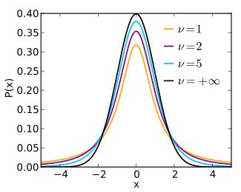
Modeling financial returns
Latent causes
(Parameters)
location
scale
tails
Distribution
of Data
Inference: Bayes Formula
probability of parameters given data
Student-T Distribution
Observed Data
Notes:
Coming back to our original problem of comparing in and out-of-sample returns we can build a specific model that assumes returns to be T-distributed rather than normal.
Besides the location and scale parameter, or mean and variance, this distribution has a third parameter that controls how much mass there is in the tails to account for these extreme events we frequently observe in the stock-market.

Slide 12

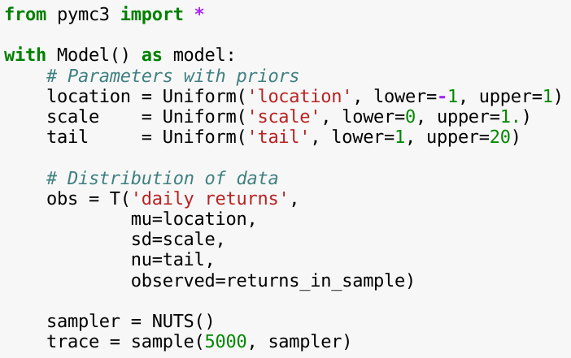
Probabilistic Programming with PyMC3
location
scale
tails
Model specification
T-Distribution
Inference
Notes:
Lets look at how this model would look like in PyMC3 -- a new probabilistic programming framework written in Python and which I helped develop.
After importing and setting up the model context we have to define the unobservable parameters of our model.
As this is a Bayesian framework we have to specify priors which allow me to define my belief about possible parameter values before I have seen any data. Here I’m just assigning equal belief in a fixed interval but you have many choices here. Informative priors are very powerful to constrain the model and apply regularization.
Once the parameters are defined we have to relate them to the distribution of the data which is T as we said before.
Note how the first parameter is a name I can give to the distribution and how the three parameters of the T distribution connect up with the definition of the parameters above.
Using the observed keyword argument we pass in our observed data -- which is just an array of the daily returns of either the in or out-of-sample returns. We will run this model on the two data sets independently.
So far this code only specifies the model and under the hood builds up a compute graph in theano which we then just-in-time-compile to C for speed.
So that part is the model specification.
To actually run MCMC sampling to infer the parameters we instantiate a sampler object. Here we are using the NUTS sampler which is a very recent development that revolutionized probabilistic programming as it this sampler works on models that are way more complex than this one.
We then draw 5000 samples from the so-called posterior which will contain likely values of the parameters given the data.

Slide 13
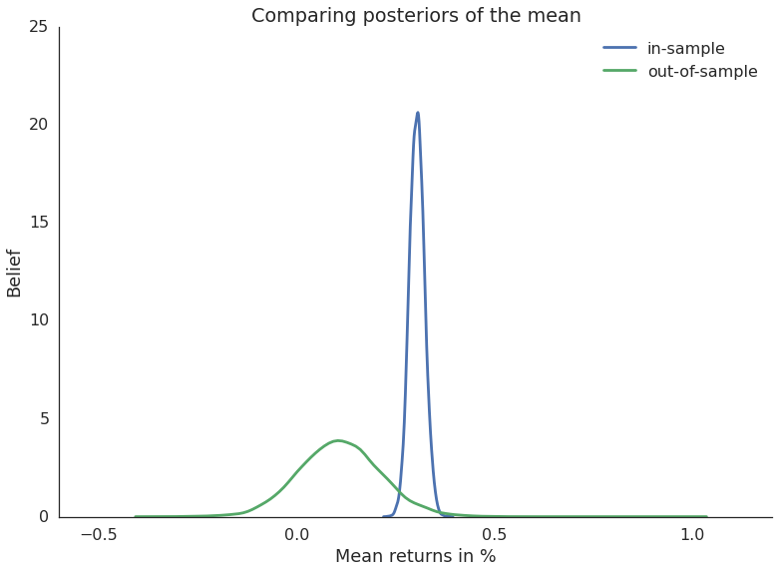
Comparing mean returns
in-sample vs out-of-sample
Notes:
Now to answer our original question, whether the out-of-sample period matches what was suggested by the backtest we can check if the mean of the two distributions is significantly different.
Here we just plot the posterior of the mean returns. It is important to note that this is *not* the returns-distribution itself, but rather our belief in the mean of the returns-distribution. Because we are doing Bayesian statistics, the mean is not a single number but actually a probability distribution that tells us how likely different mean values are. Intuitively, the wider the distribution the more uncertainty we have so you can see that with only a few days of out of-sample data our uncertainty in the mean of that period is much higher than for the backtest period for which we consider a much smaller parameter range as likely.
Given these posteriors we can now ask statistically meaningful questions like what is the probability that the mean returns of the in-sample period is smaller than the out-of-sample period.
3.34% which is very low so in this case we are fairly certain that the backtest is overfit on historical data.

Slide 14
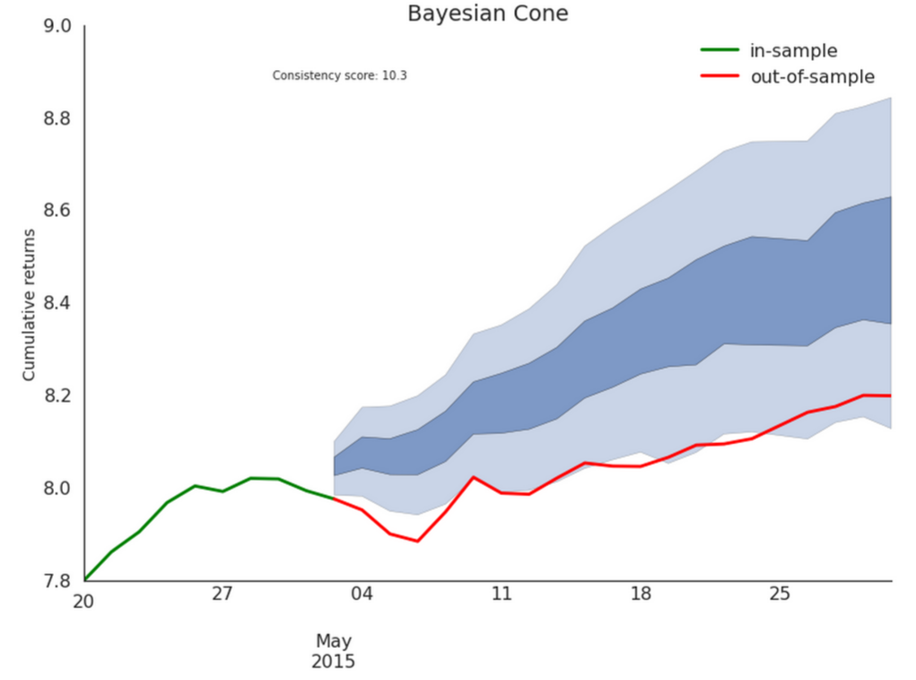
Prediction of possible future returns
Estimate model
Generate returns from model using parameters drawn from posterior (each parameter setting gives one set of returns)
Region of low probability
Region of high probability
Notes:
Just briefly I also wanted to show you that you can not only do inference and learn about your data but you can also do prediction like with machine learning.
In this case we can simulate future returns from the model and visualize them with this cone here.
The darker colored region represents where we predict the strategy to head with highest probability and light blue with lower probability.
In this case the out-of-sample period quickly walks out of this prediction cone which further supports our previous result that the backtest was overfit.

Slide 15
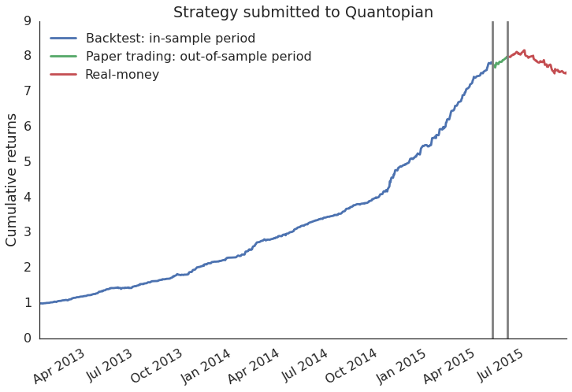
What actually happened
Winner of our trading competition so we deployed real money to that strategy
Notes:
With probabilistic programming we now have a tool to alert us to these problems much sooner so that this won’t happen again.

Slide 16
Advanced demo
Go to: https://gist.github.com/anonymous/d7d6ee33e06ba1845dda94b5137dfba3
Ready for something cool?

Slide 17
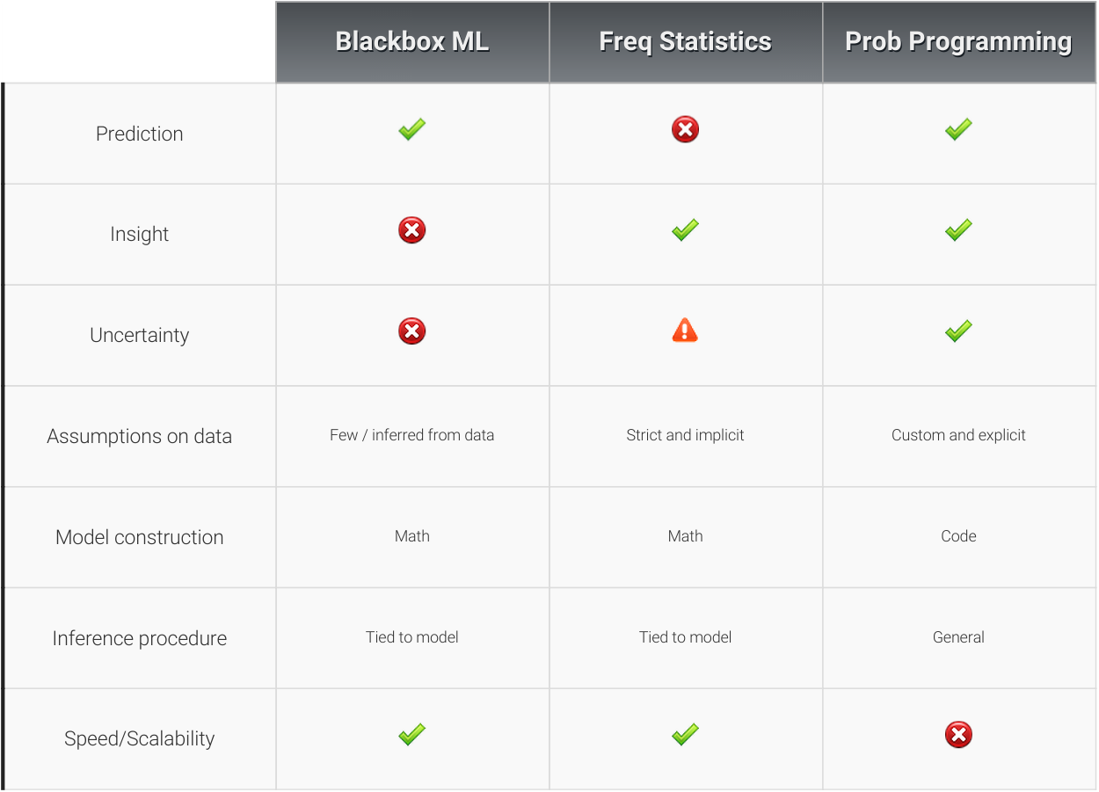
Notes:
To summarize I wanted to give a quick side-by-side comparison of the various approaches.
I showed that probabilistic programming is well suited to provide insight into data as well as do prediction, just like machine learning.
Since we’re using Bayesian statistics we are tracking uncertainty in a more direct way than what frequentist statistics offers.
Finally, the real power comes from the fact that we can build custom models in code and have a very general inference algorithm that works transparently on almost any model you throw at it.
All this, however, comes at increased computational cost. But with better samplers and faster computers this is becoming less of a problem. Personally, if I had to chose between insight and computation time, I’d always chose insight.

Slide 18
Further reading
Quantopian: https://www.quantopian.com
PyMC3: https://github.com/pymc-devs/pymc3
Blog post on models: http://blog.quantopian.com/bayesian-cone/
All these models are implemented in pyfolio: https://github.com/quantopian/pyfolio/
My blog: https://twiecki.github.io
Probilistic Programming for Hackers: http://camdavidsonpilon.github.io/Probabilistic-Programming-and-Bayesian-Methods-for-Hackers/
Doing Bayesian Data Analysis: http://www.indiana.edu/~kruschke/DoingBayesianDataAnalysis
Twitter: @twiecki
Notes:
I realize that 15 minutes are probably not enough time to give a complete introduction to probabilistic programming, but if I peaked your interest, here are a bunch of links to learn more about this technique.
And with that I’d like to thank you for your attention.

Slide 19
Disclaimer
This presentation is for informational purposes only and does not constitute an offer to sell, a solicitation to buy, or a recommendation for any security; nor does it constitute an offer to provide investment advisory or other services by Quantopian, Inc. ("Quantopian"). Nothing contained herein constitutes investment advice or offers any opinion with respect to the suitability of any security, and any views expressed herein should not be taken as advice to buy, sell, or hold any security or as an endorsement of any security or company. In preparing the information contained herein, Quantopian, Inc. has not taken into account the investment needs, objectives, and financial circumstances of any particular investor. Any views expressed and data illustrated herein were prepared based upon information, believed to be reliable, available to Quantopian, Inc. at the time of publication. Quantopian makes no guarantees as to their accuracy or completeness. All information is subject to change and may quickly become unreliable for various reasons, including changes in market conditions or economic circumstances.

